Slide 1


Slide 2
Weekly Updates
Please provide a quick update on either:
Something you did/saw this week that you thought was interesting
What you’re looking forward to about this week’s workshop
(Reminder - please have your cameras on if possible)

Slide 3
Workshop 3
Data Analysis & Visualization

Slide 4

Recap

Slide 5
Sessions Overview
Workshop 1 – Project Introduction & Setup
Workshop 2 – Genomic Data (A2 Assignment)
Workshop 3 – Data Analysis & Visualization (A3 Assignment)
Workshop 4 – Featurization & Baseline Modeling (A4 Assignment)
Workshop 5 – Model Training Approaches (Final Assignment Set)
Workshop 6 – Model Tuning
Workshop 7 – Performance Evaluation (Final Assignment Code/Testing Due)
Workshop 8 – Results Presentation & Wrap up (Final Presentation Due)

Slide 6
Data Collection
Reviewed publicly available genomes & AMR data on BV-BRC
Downloaded metadata on AMR tests
Downloaded genome metadata
Subset to Escherichia coli + cefepime only
Download genomic sequences
Download CARD data
Assignment:
Aligned the CARD gene sequences against our genome sequences

Slide 7
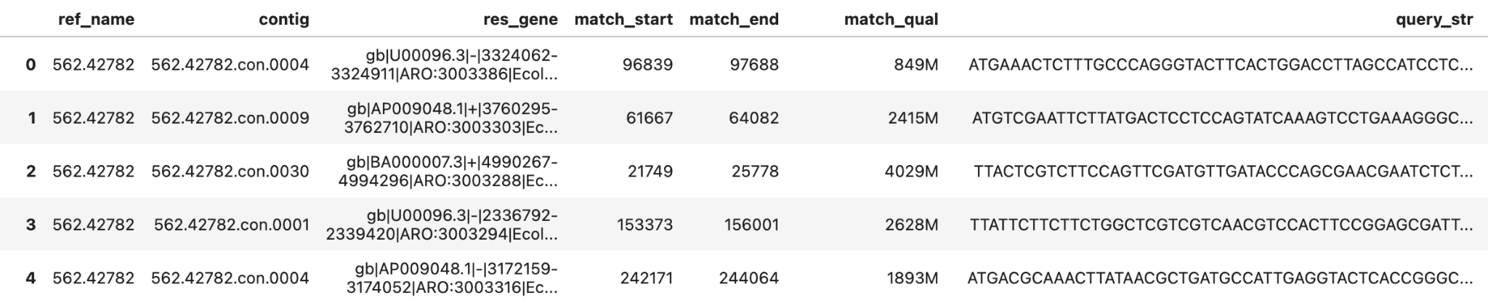
Data used this Workshop
AMR Data (subset to E coli + cefepime) - downloaded and reviewed in class last week
Genome Summary Data (subset to E coli) - downloaded and reviewed in class last week
Aligned Genes to Genomes (from assignment):

Slide 8
Data Science Process

Slide 9
What is the Data Science Process?
Understand the Problem
Gather Data
Explore & Analyze Data
Repeat as needed:
Data Science is an iterative process
Featurize Data
Model Building
Evaluate and Compare
Present Results

Slide 10
What is the Data Science Process?
Understand the Problem
Gather Data
Explore & Analyze Data
Repeat as needed:
Data Science is an iterative process
Featurize Data
Model Building
Evaluate and Compare
Present Results

Slide 11
QUIZ TIME !?
Why should we visualize data?
To make complex patterns easier to understand
To help us form hypotheses
To hide or manipulate information
To summarize and present information to others

Slide 12
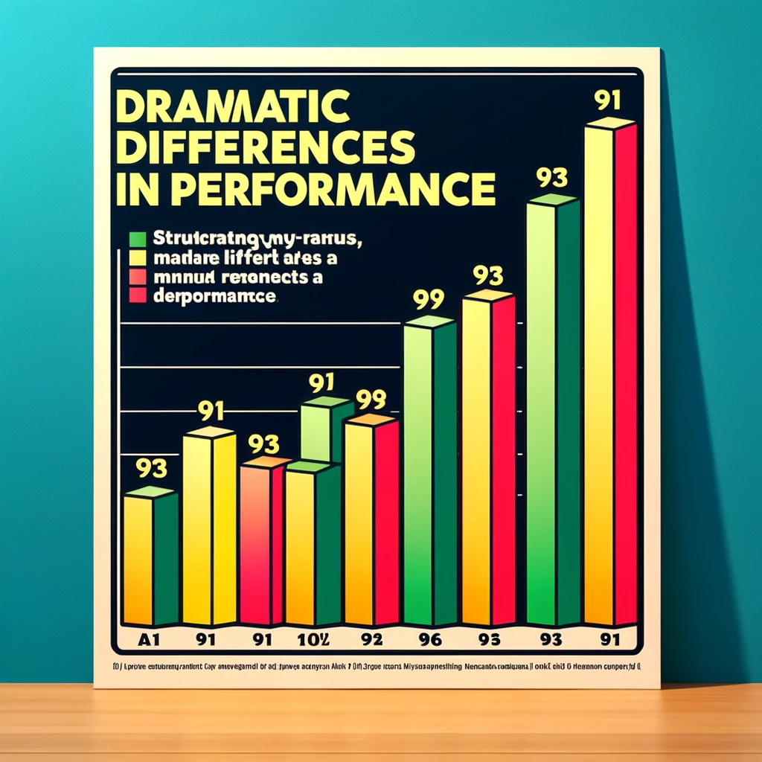
Why is EDA Important?
Data Quality
Understanding Patterns
Generating Hypotheses
Informing Model Selection
Communicating Findings
ChatGPT can make some really misleading graphs

Slide 13
Best Practices
EDA approaches will inherently vary depending on the type of problem and data.
A few common best practices:
Take a manual look through your data
Summarize your descriptive statistics (missingness, counts, data types)
Use a combination of tables & visualization
Don’t be afraid to iterate
When building a visualization also:
Think about your target audience (scientific vs consumer)
Formulate your question ahead of time
Decide which specific facet you’re trying to visualize (comparison, distribution, time series)
Make it understandable (always add titles, label your axes)
Summarize your interpretations

Slide 14
Python Libraries

Slide 15
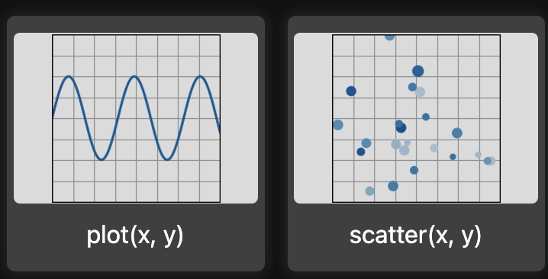
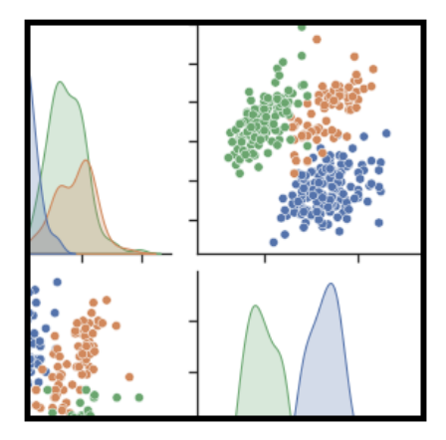
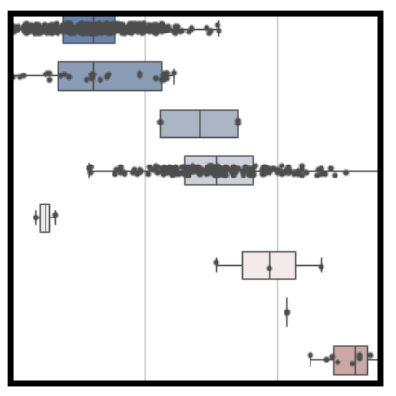
Matplotlib & Seaborn
Matplotlib is the most ubiquitous plotting library for Python
Highly flexible
Low level
Seaborn is a fantastic extension to Matplotlib that provides a higher level interface for common statistical visualizations
Easy interfaces
Attractive visuals
Good summarization
We’ll be leveraging both together in this workshop (see documentation for more details)
[1]
[2]

Slide 16
Alternatives
Whilst we’ll be using Matplotlib + Seaborn there are a huge array of tools & libraries available for exploring and visualizing data, many of which serve a specific niche or purpose:
Plotly - Interactive visualizations
Altair - Declarative python library
Tableau/Power BI - Interactive dashboards
R + RShiny - Statistical analysis & dashboarding
D3 - Complex & highly interactive visualizations (JavaScript)

Slide 17
Examples for Genomic Data

Slide 18
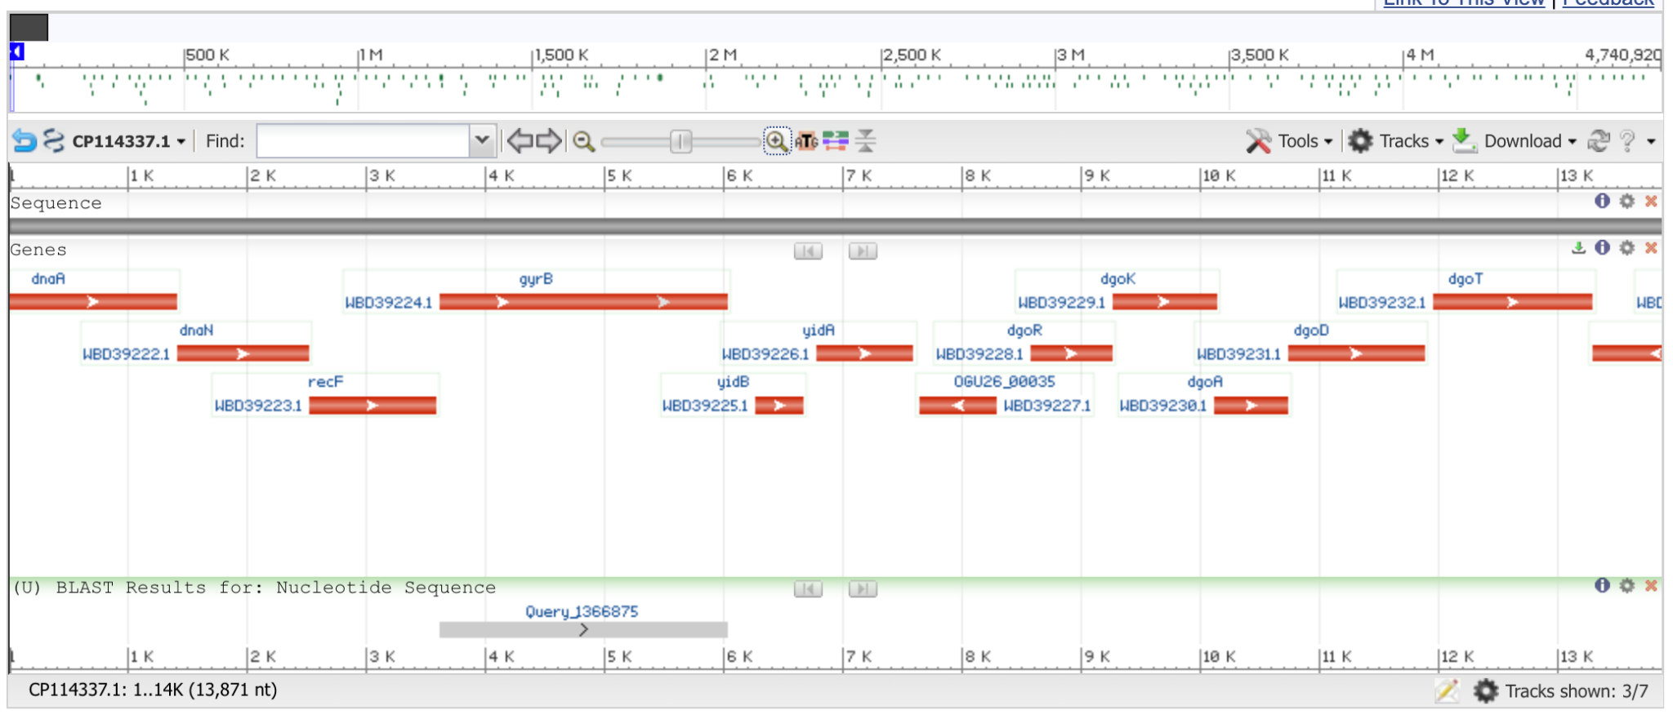
NCBI Blast
In the assignment last week, you aligned resistance genes to the Escherichia coli genomes
NCBI Blast is a tool for doing the same but with a webportal and a set of great genomic visualizations:
As an example I took a random genes from our CARD data and ran it through Blast
Check it out at this link
[3]

Slide 19
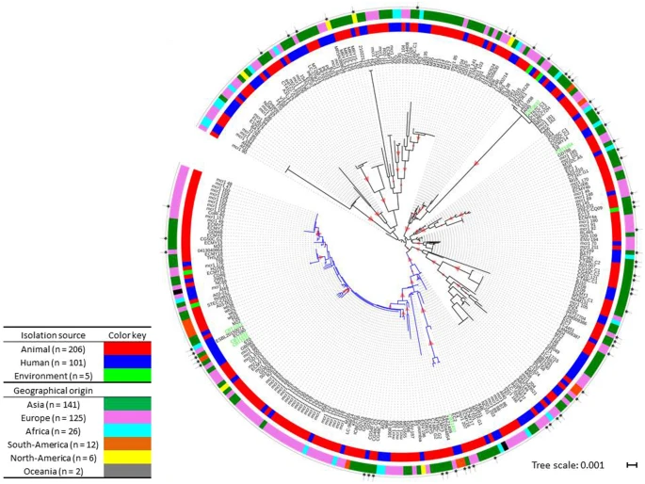
Escherichia coli Phylogeny
In this build project we’re working with Escherichia coli
It’s common to want to understand the grouping and relationships between strains
This circle of doom on the right represents a subset of the E coli “Phylogeny”
[4]

Slide 20
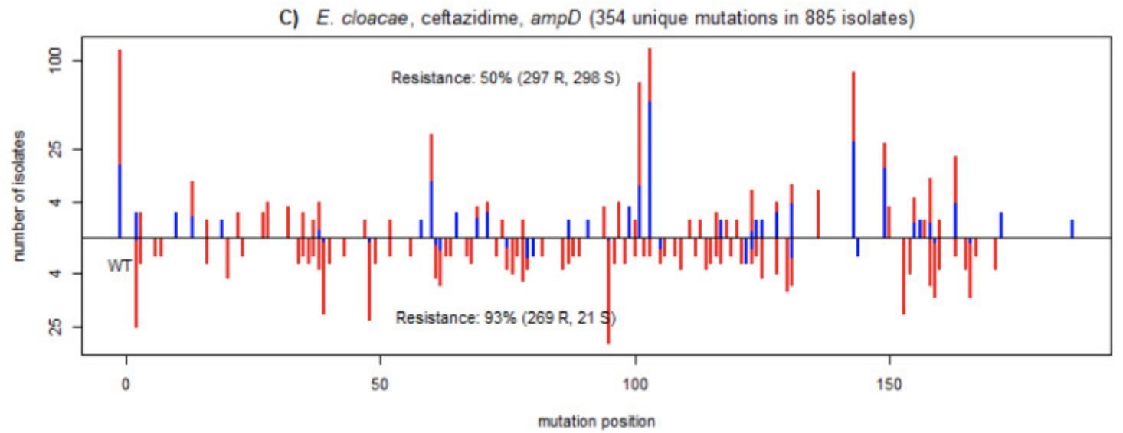
Gene Mutations
In a 2021 publication Majek et al. showed a really interesting relationship between mutations in a gene and AMR phenotype
Great use of positional information in X (gene position) and Y (counts)
Color to show S vs R phenotype
[5]

Slide 21
Workshop 3
EDA

Slide 22
References
[1]:https://matplotlib.org/stable/plot_types/index.html
[2]:https://seaborn.pydata.org/
[3]:https://blast.ncbi.nlm.nih.gov/Blast.cgi
[4]:https://www.nature.com/articles/s41598-017-15539-7
[5]:https://www.ncbi.nlm.nih.gov/pmc/articles/PMC8657983/

